Slide 1
Reality TV Show Tarak Mehta Ka Ulta Chashma
Team: Tapu Sena

Slide 2
Team Members:
-Haireet Mehta
—Kaushal Mhatre
—Shubham Jain
—Harsh Mohite
—Shreyansh Jain
—Aaryan K.

Slide 3

TRP Analysis: Taarak Mehta Ka Oolta Chashma
This presentation delves into the TRP analysis of Taarak Mehta Ka Oolta Chashma (TMKOC), a popular Indian sitcom. We will examine the show's viewership trends, demographic insights, and impact of key storylines on its ratings.

Slide 4
1. Sampling:
Random Sampling: Since it's impractical to install people meters in every household, a sample of households is selected. These households are chosen randomly to represent the larger population.Stratified Sampling: To ensure representation from different demographic segments (age groups, income levels, urban vs rural), stratified sampling is often used. Each segment is proportionally represented in the sample.

Slide 5
2. Data Collection:
Frequency Distribution: People meters capture data on how frequently a show is watched, and these frequencies are distributed across different demographics to analyze patterns.Time Series Data: Viewership data is collected over time, making it a time series. This allows for trend analysis, seasonality checks, and identifying viewership peaks or troughs.

Slide 6
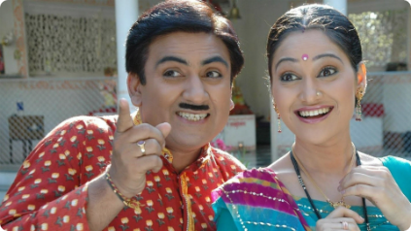
Overview of Taarak Mehta Ka Ulta Chasma
Engagement
TMKOC is a popular Indian sitcom that has been running for over 14 years. The show follows the lives of a group of families residing in a fictional housing society in Mumbai. It has gained widespread popularity for its relatable characters, humorous storylines, and focus on Indian family values.
Conversions

Slide 7

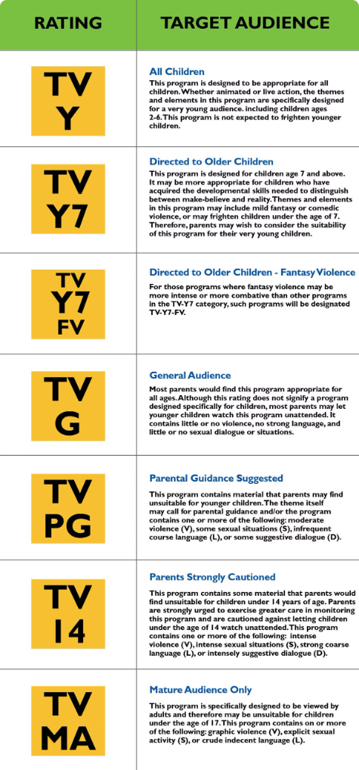
Viewership Trends and Ratings
TMKOC has consistently ranked among the top-rated shows in India. The show enjoys a large and loyal viewership base, with TRPs typically exceeding 2.5 points. This indicates a strong audience engagement and a preference for the show's content.
1
Initial Years (2008-2012)
The show gained popularity quickly, establishing itself as a consistent top-rated sitcom in the Indian television landscape.
2
Growth and Peak (2013-2017)
During this period, TMKOC achieved its highest TRP ratings, cementing its position as a national phenomenon.
3
Continued Popularity (2018-Present)
Despite facing competition from new shows, TMKOC has maintained its strong viewership base, indicating the show's enduring appeal.

Slide 8

Demographic Analysis
TMKOC's viewership spans across a wide demographic spectrum, catering to audiences of all ages, genders, and socioeconomic backgrounds. The show's appeal lies in its ability to resonate with the diverse experiences of the Indian population.
Age Group
Viewership Share
15-24
25%
25-34
35%
35-44
20%
45-54
15%
55+
5%

Slide 9
Seasonal Variations in TRP
The show's TRPs tend to fluctuate based on seasonal factors. The festive season in India, particularly Diwali and Holi, often witness a surge in viewership for TMKOC. This is likely due to the show's inclusion of special episodes that incorporate traditional elements and celebrations.
Festival Seasons
Summer Months
Other Seasons
During festivals, viewers often prefer to watch light-hearted and family-friendly content like TMKOC, leading to higher ratings.
During the summer months, school holidays result in a larger family audience watching television, contributing to increased viewership.
The TRPs remain relatively consistent throughout the year, suggesting a loyal viewership base that watches the show regardless of the season.

Slide 10
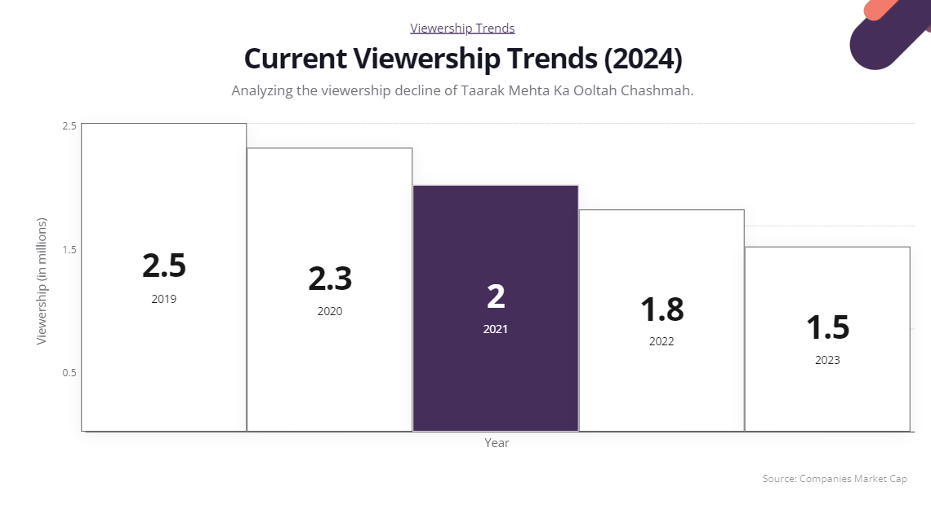

Slide 11

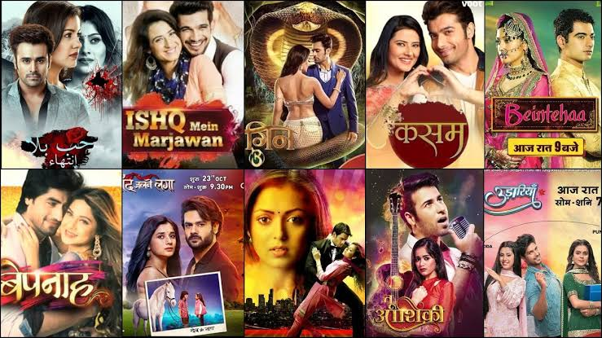




Comparison to Competing Shows
TMKOC faces stiff competition from other popular sitcoms and reality shows in the Indian television market. However, the show has consistently outperformed its competitors in terms of viewership and ratings.
Strong Brand Recognition
Wide Audience Appeal
TMKOC has established a strong brand recognition over the years, making it a familiar and preferred choice for viewers.
The show caters to a broad demographic, ensuring its appeal to a wide audience, thus outperforming niche shows.
Emotional Connection
Consistent Quality
The show's relatable characters and storylines create an emotional connection with viewers, keeping them engaged and loyal.
The show consistently delivers high-quality content, keeping viewers entertained and coming back for more.

Slide 12
Clustering and Segmentation:
Cluster Analysis: Statistical clustering methods (e.g., k-means clustering) can group viewers based on their viewing habits, allowing for more targeted content and advertising strategies.Principal Component Analysis (PCA): This technique reduces the dimensionality of the data, helping identify the key factors (e.g., demographics, time slots) that influence viewership.

Slide 13
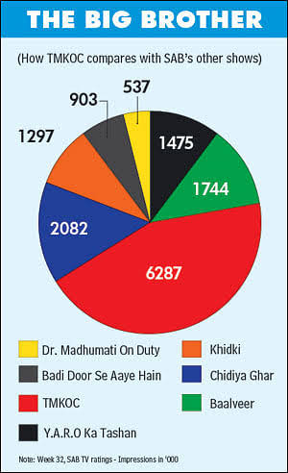

Slide 14
Correlation & Causation:
Correlation Analysis: Measures how different factors (e.g., advertising frequency, channel type) correlate with TRP values. However, this doesn't imply causation.Causal Inference: Advanced statistical models, like structural equation modeling, attempt to establish causal relationships between variables (e.g., whether a rise in marketing efforts led to a rise in TRP).

Slide 15
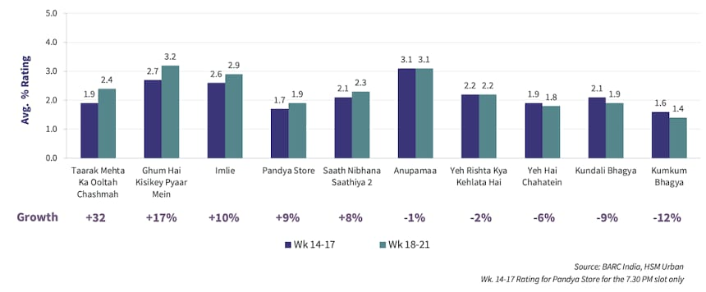
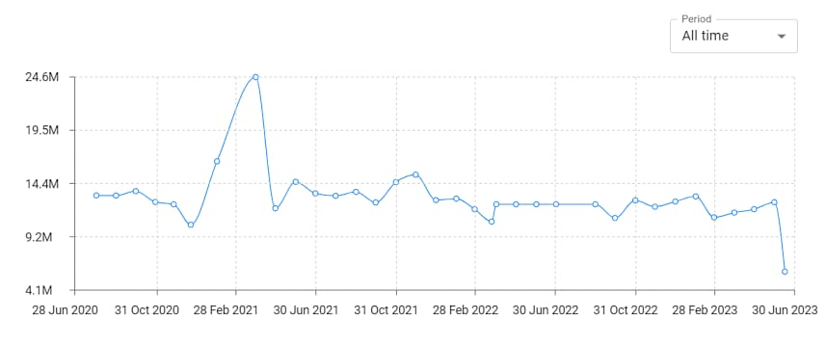

Slide 17

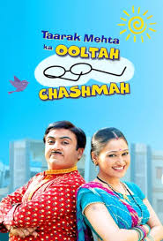
Conclusion and Key Takeaways
Taarak Mehta Ka Oolta Chashma continues to dominate the Indian television landscape, achieving sustained success due to its relatable characters, humorous storylines, and focus on Indian family values. The show's strong TRPs and wide demographic appeal demonstrate its enduring popularity among Indian viewers.
Engaging Storylines
Relatable Characters
The show's success is a testament to the power of engaging storylines that resonate with viewers.
Characters that are relatable and believable are key to creating a lasting impression on viewers.
Strong Brand Recognition
Building a strong brand identity is crucial for long-term success, as it fosters viewer loyalty.

Slide 18
Thanks
Chai piyo, Biscuit Khao
Please keep this slide for attribution

